Slide 1


Iodine-131 Wholebody Dosimetry
IDUG Workshop – BNMS 2026
Dr Hugh J Wallace
Principal Clinical Scientist
Paediatric Nuclear Medicine & SMaRT Kids
Royal Hospital for Children, Glasgow

Slide 2

The Plan
Theory
Why Wholebody Dose?
Making Measurements
Getting to Dose
Practical
Workshop Cases

Slide 3
Why Wholebody Dose?
Correlates with blood dose
  Which correlates with bone marrow dose
  Which correlates with haemotoxicity
  Which is the dose limiting acute toxicity for Iodine-131
Allows standardisation based on toxicity
  No haemotoxicity up to 2Gy
  Stem cell transplant required at 4Gy
→ Reliable patient management

Slide 4
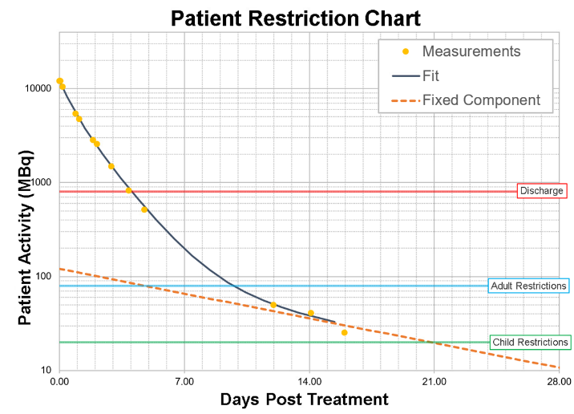
Why Wholebody Dose?
Straightforward to measure
  You’re probably already
  gathering it for discharge
~Straightforward to calculate
  Single excretion curve
  Single weight-based S-Factor

Slide 5
Why Wholebody Dose?
Fixed-activity and weight-based are not good enough
Fixed 3700MBq:
  → 0.13 - 0.39 Gy
  Factor of x3
1.06x10⁻⁴ Gy/MBq
0.35x10⁻⁴ Gy/MBq

Slide 6
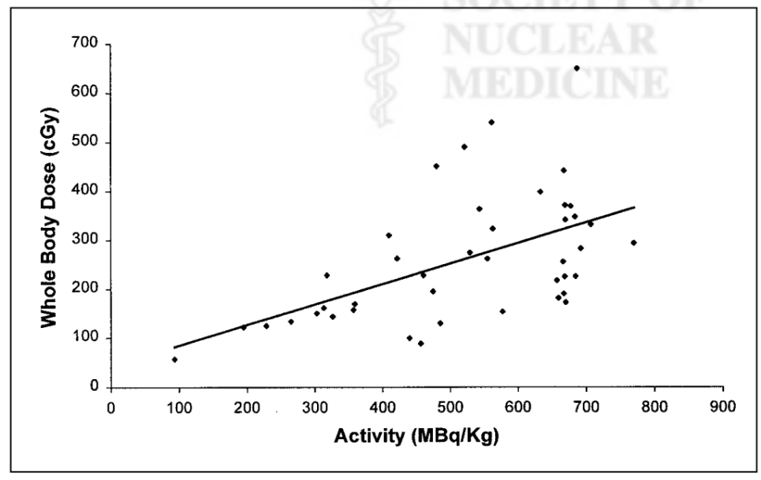
Correlation of administered activity of ¹³¹I-mIBG/kg and wholebody radiation dose
Matthay et al. 2001 J Nucl Med https://pubmed.ncbi.nlm.nih.gov/11696644/

Slide 7
Correlation of administered activity of ¹³¹I-mIBG/kg and wholebody radiation dose
Factor of
x5
Upper ~ 1.0 x Activity/kg
Lower ~ 0.2 x Activity/kg
Matthay et al. 2001 J Nucl Med https://pubmed.ncbi.nlm.nih.gov/11696644/

Slide 8
Making Measurements
200
150
Measurement (units)
The Goal
Total activity vs time over multiple days
Requires
Equipment
Data recorded
Methodology
100
50
0
Time
4000
3000
Activity (MBq)
2000
1000
0
Time

Slide 9
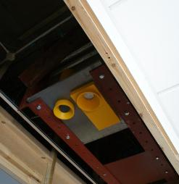
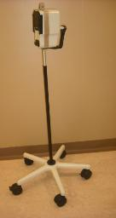
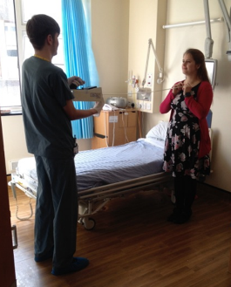
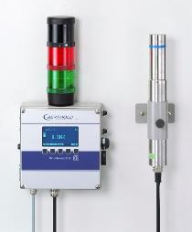
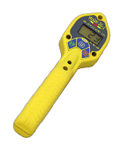
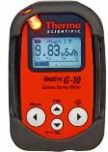
Making Measurements
Equipment
Essential:
  Linear response
  Suitable range
  Backup available
Nice to have:
  Fixed installation (e.g. ceiling mounted)
  Energy compensated
  Calibrated

Slide 10
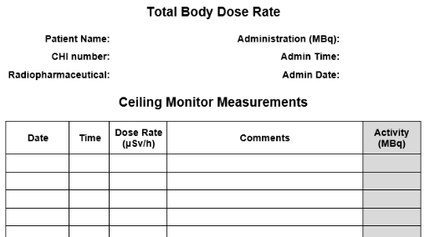
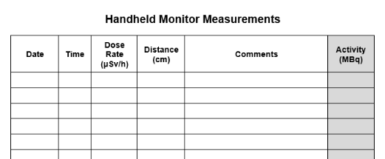
Making Measurements
Data Recorded
Administered Activity + Date + Time
Patient weight
Measurement + Date + Time
Patient status (e.g. post void)
Geometry (e.g. distance, bed height)

Slide 11
Making Measurements
Data Recorded
Administered Activity + Date + Time
Patient weight
Measurement + Date + Time
Patient status (e.g. post void)
Geometry (e.g. distance, bed height)
→ Recording reinforces good practice

Slide 12
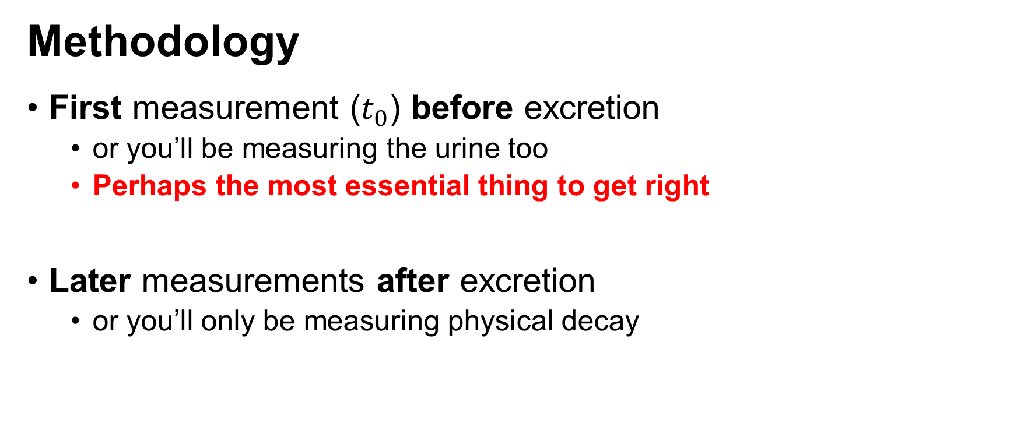
Making Measurements
Methodology
First measurement ($t_{0}$) before excretion
  or you’ll be measuring the urine too
  Perhaps the most essential thing to get right
Later measurements after excretion
  or you’ll only be measuring physical decay

Slide 13
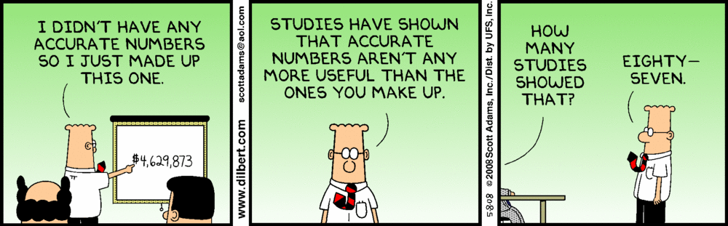
Making Measurements
Methodology
All measurements consistent geometry
  or you may as well make up the numbers

Slide 14
Making Measurements
What about frequency?
Frequency | Schedule | Example Timings (h) | Potential Contributing Factors
Ideal | Multiple optimised time points per day | 0, 2, 4, 6, 8, 10 20, 22, 24, 28, 32 44, 48, 52, 60 | Well staffed centre Strong interest in dosimetry Nurses/C&Cs able to measure Compliant patient
Good / Adequate | 2 per day | 0, 8 22, 32 48, 56 | Busy centre / less staffing Nurses/C&Cs unable to measure Less compliant patient
Minimum | 1 per day | 0 24 48 | Very busy centre / minimum staffing Nurses/C&Cs unable to measure Poorly compliant patient

Slide 15
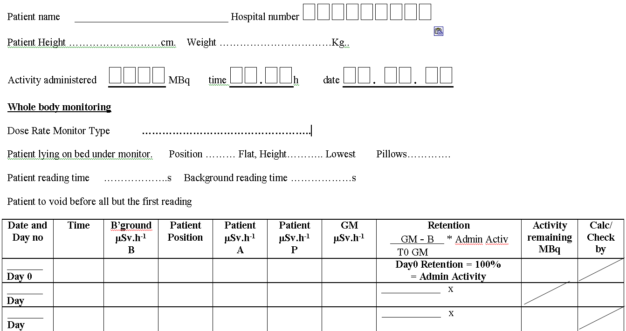
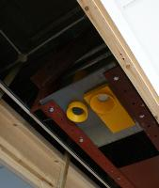
Making Measurements
Examples
The Christie
Daily/Twice by staff
Ceiling monitor, bed lowest position
Anterior/Posterior for geomean
Addenbrooks
Hourly by patient
1m readings, floor markings
Anterior only

Slide 16
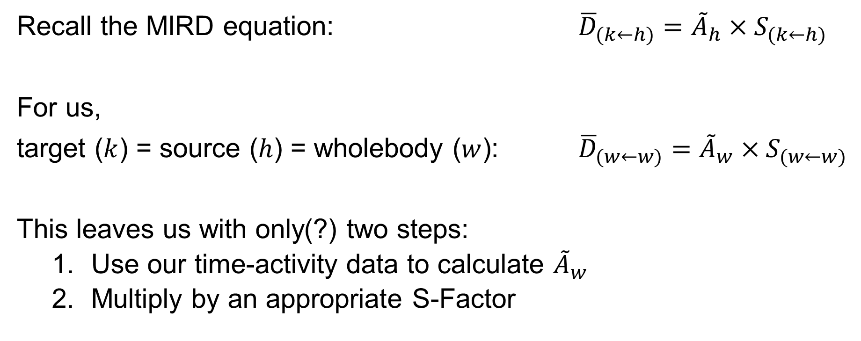
Getting to Dose
Recall the MIRD equation: ${\overline{D}}_{(k←h)}={\tilde{A}}_{h}{×S}_{(k←h)}$
For us,
target ($k$) = source ($h$) = wholebody ($w$): ${\overline{D}}_{(w←w)}={\tilde{A}}_{w}{×S}_{(w←w)}$
This leaves us with only(?) two steps:
  Use our time-activity data to calculate ${\tilde{A}}_{w}$
  Multiply by an appropriate S-Factor

Slide 17
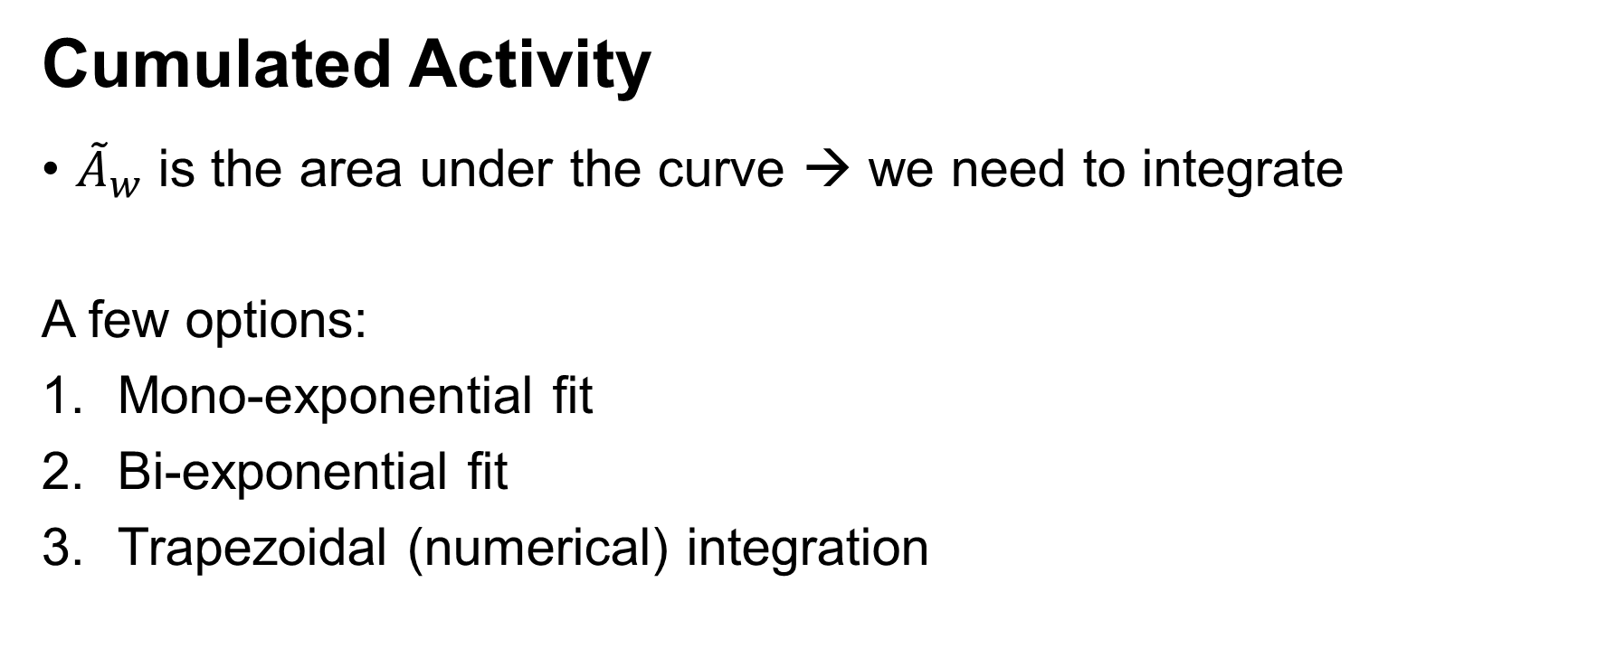
Getting to Dose
Cumulated Activity
${\tilde{A}}_{w}$ is the area under the curve → we need to integrate
A few options:
Mono-exponential fit
Bi-exponential fit
Trapezoidal (numerical) integration

Slide 18
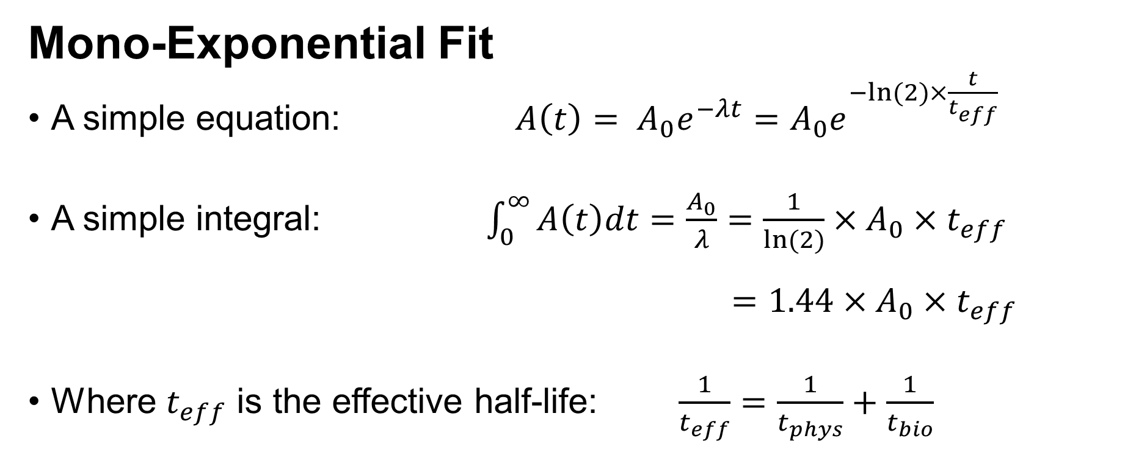
Getting to Dose
Mono-Exponential Fit
A simple equation: $A\left(t\right)= A_{0}e^{−λt}=A_{0}e^{−ln⁡(2)×\frac{t}{t_{eff}}}$
A simple integral: $\int_{0}^{∞}{A\left(t\right)dt}=\frac{A_{0}}{λ}=\frac{1}{ln⁡(2)}×A_{0}×t_{eff}$
$=1.44×A_{0}×t_{eff}$
Where $t_{eff}$ is the effective half-life: $\frac{1}{t_{eff}}=\frac{1}{t_{phys}}+\frac{1}{t_{bio}}$

Slide 19
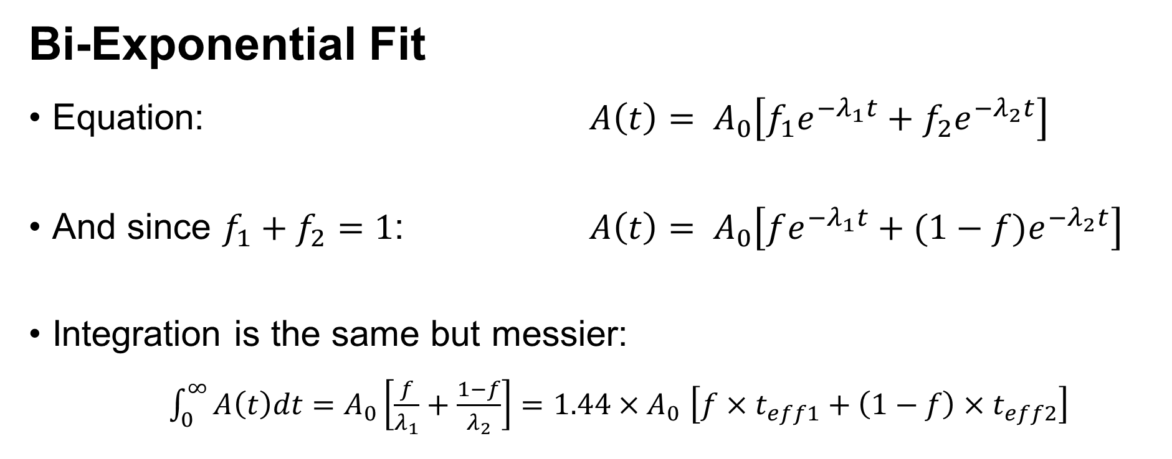
Getting to Dose
Bi-Exponential Fit
Equation: $A\left(t\right)= A_{0}\left[f_{1}e^{−λ_{1}t}+f_{2}e^{−λ_{2}t}\right]$
And since $f_{1}+f_{2}=1$: $A\left(t\right)= A_{0}\left[fe^{−λ_{1}t}+(1−f)e^{−λ_{2}t}\right]$
Integration is the same but messier:
  $\int_{0}^{∞}{A\left(t\right)dt}=A_{0}\left[\frac{f}{λ_{1}}+\frac{1−f}{λ_{2}}\right]=1.44×A_{0}$ $\left[f×t_{eff1}+\left(1−f\right){×t}_{eff2}\right]$

Slide 20
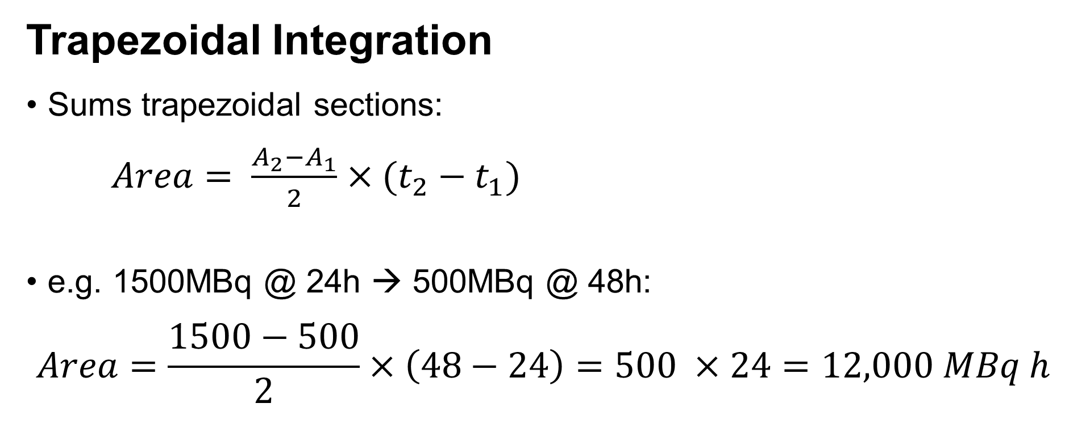
Getting to Dose
4000
3000
Activity (MBq)
Trapezoidal Integration
Sums trapezoidal sections:
$Area= \frac{A_{2}−A_{1}}{2}×(t_{2}−t_{1})$
e.g. 1500MBq @ 24h → 500MBq @ 48h:
$$Area=\frac{1500−500}{2}×\left(48−24\right)=500 ×24=12,000 MBq h$$
2000
1000
0
Time

Slide 21


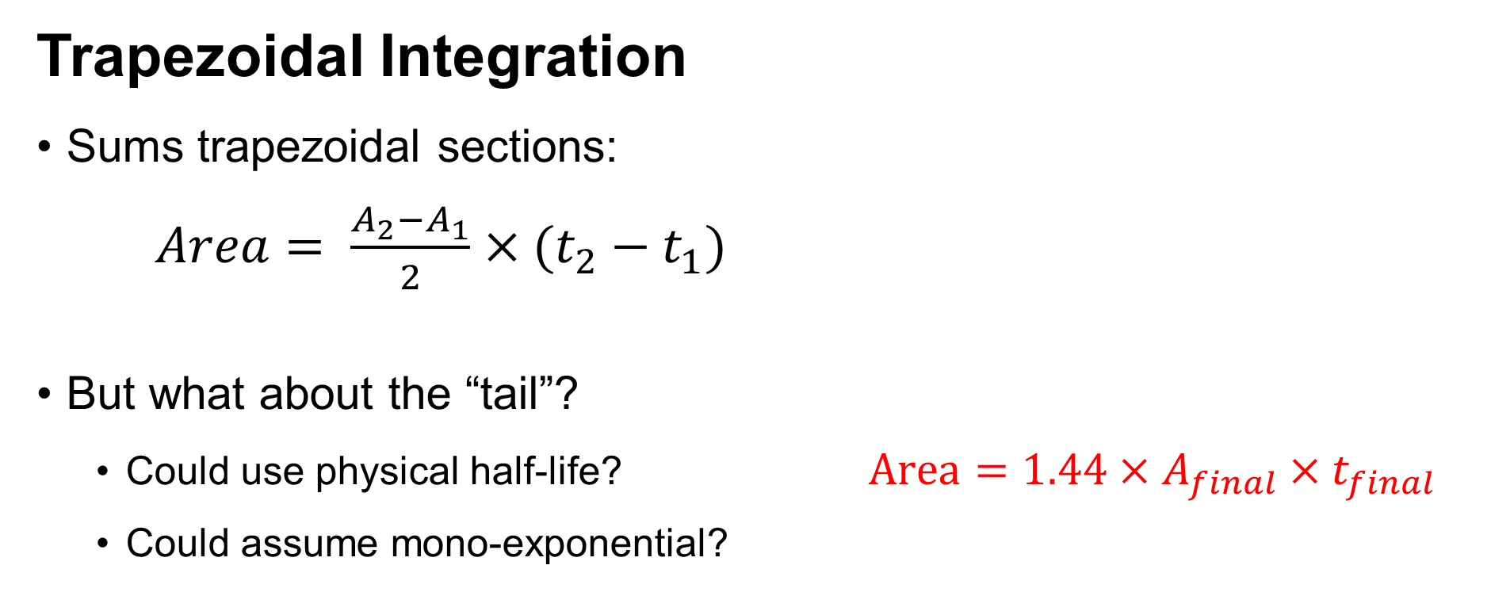



Getting to Dose
4000
$$A_{1}$$
3000
$$A_{2}$$
Activity (MBq)
Trapezoidal Integration
Sums trapezoidal sections:
$Area= \frac{A_{2}−A_{1}}{2}×(t_{2}−t_{1})$
But what about the “tail”?
  Could use physical half-life? $Area={1.44×A}_{final}×t_{final}$
  Could assume mono-exponential?
2000
$$A_{3}$$
1000
$$A_{4}$$
$$A_{final}$$
0
Time

Slide 22
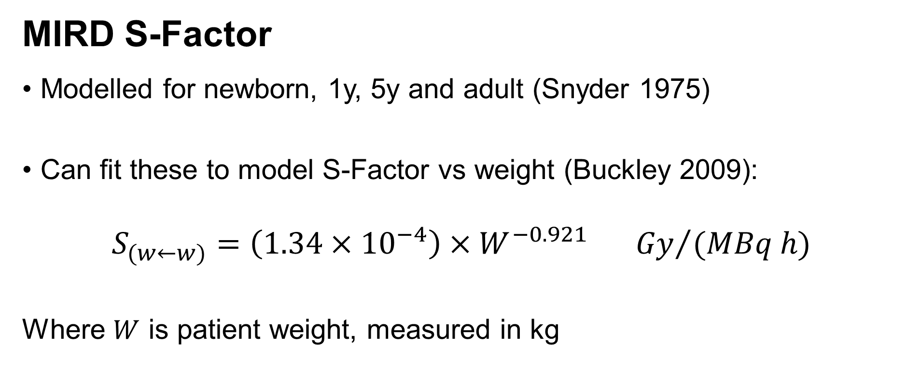
Getting to Dose
MIRD S-Factor
Modelled for newborn, 1y, 5y and adult (Snyder 1975)
Can fit these to model S-Factor vs weight (Buckley 2009):
$$S_{(w←w)}=\left(1.34×{10}^{−4}\right)×W^{−0.921} {Gy}/{(MBq h)}$$
Where $W$ is patient weight, measured in kg

Slide 23
Getting to Dose
Some Complications

Slide 24
With Thanks
Jill Tipping (The Christie)
Sarah Heard (Addenbrooke’s Hospital)
Jon Gear (The Royal Marsden Hospital)
Bruno Rojas (The Royal Marsden Hospital)
Michael Gornall (Kings College Hospital)
Matt Aldridge (Kings College Hospital)
Colin Brown (Gartnavel General Hospital, Glasgow)

Slide 25
Key References
EANM Dosimetry Committee series on standard operational procedures for internal dosimetry for 131I mIBG treatment of neuroendocrine tumours, Gear et al, 2020
EANM Dosimetry Committee guidelines for bone marrow and whole-body dosimetry, Hindorf et al, 2010
Dosimetry and thyroid cancer, Lassman et al, 2010
EANM Dosimetry Committee series on standard operational procedures for pre-therapeutic dosimetry, Lassman et al, 2008
Correlation of tumor and whole-body dosimetry with tumor response and toxicity in refractory neuroblastoma treated with (131)I-MIBG, Matthay et al 2001

Slide 26
Workshop
Case 1a. “Good data” Many points
Case 1b. “Good data” 24hr data
Case 2a. “Good data” Many points
Case 2b. “Good data” 24hr data
Case 3a. Wobbly data
Case 3b. Wobbly data, excluded points
Case 3c. Wobbly data 24hr only
Case 4a. Redistribution
Case 4b. Redistribution peak adjust
Case 5. I-123 to I -131 dose calculation.

